Slide 1

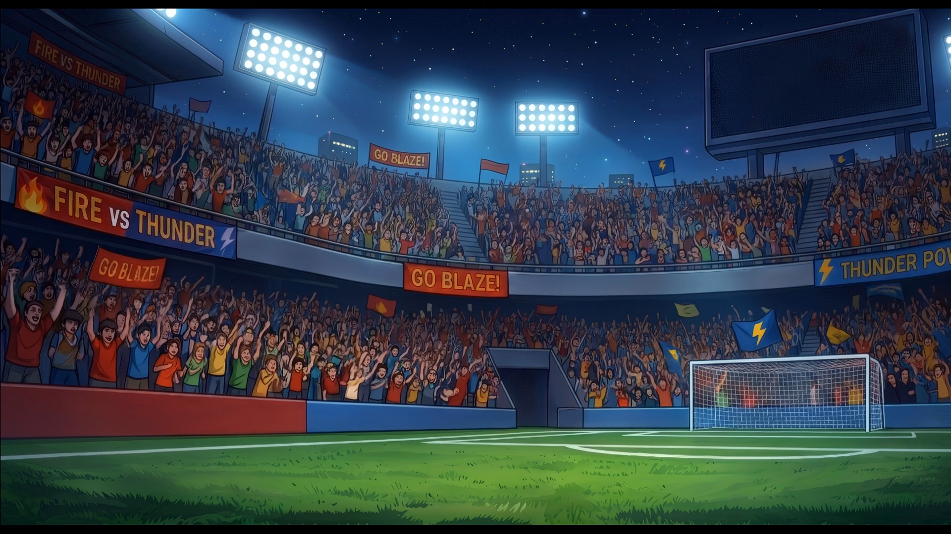



Click here to start

Slide 2
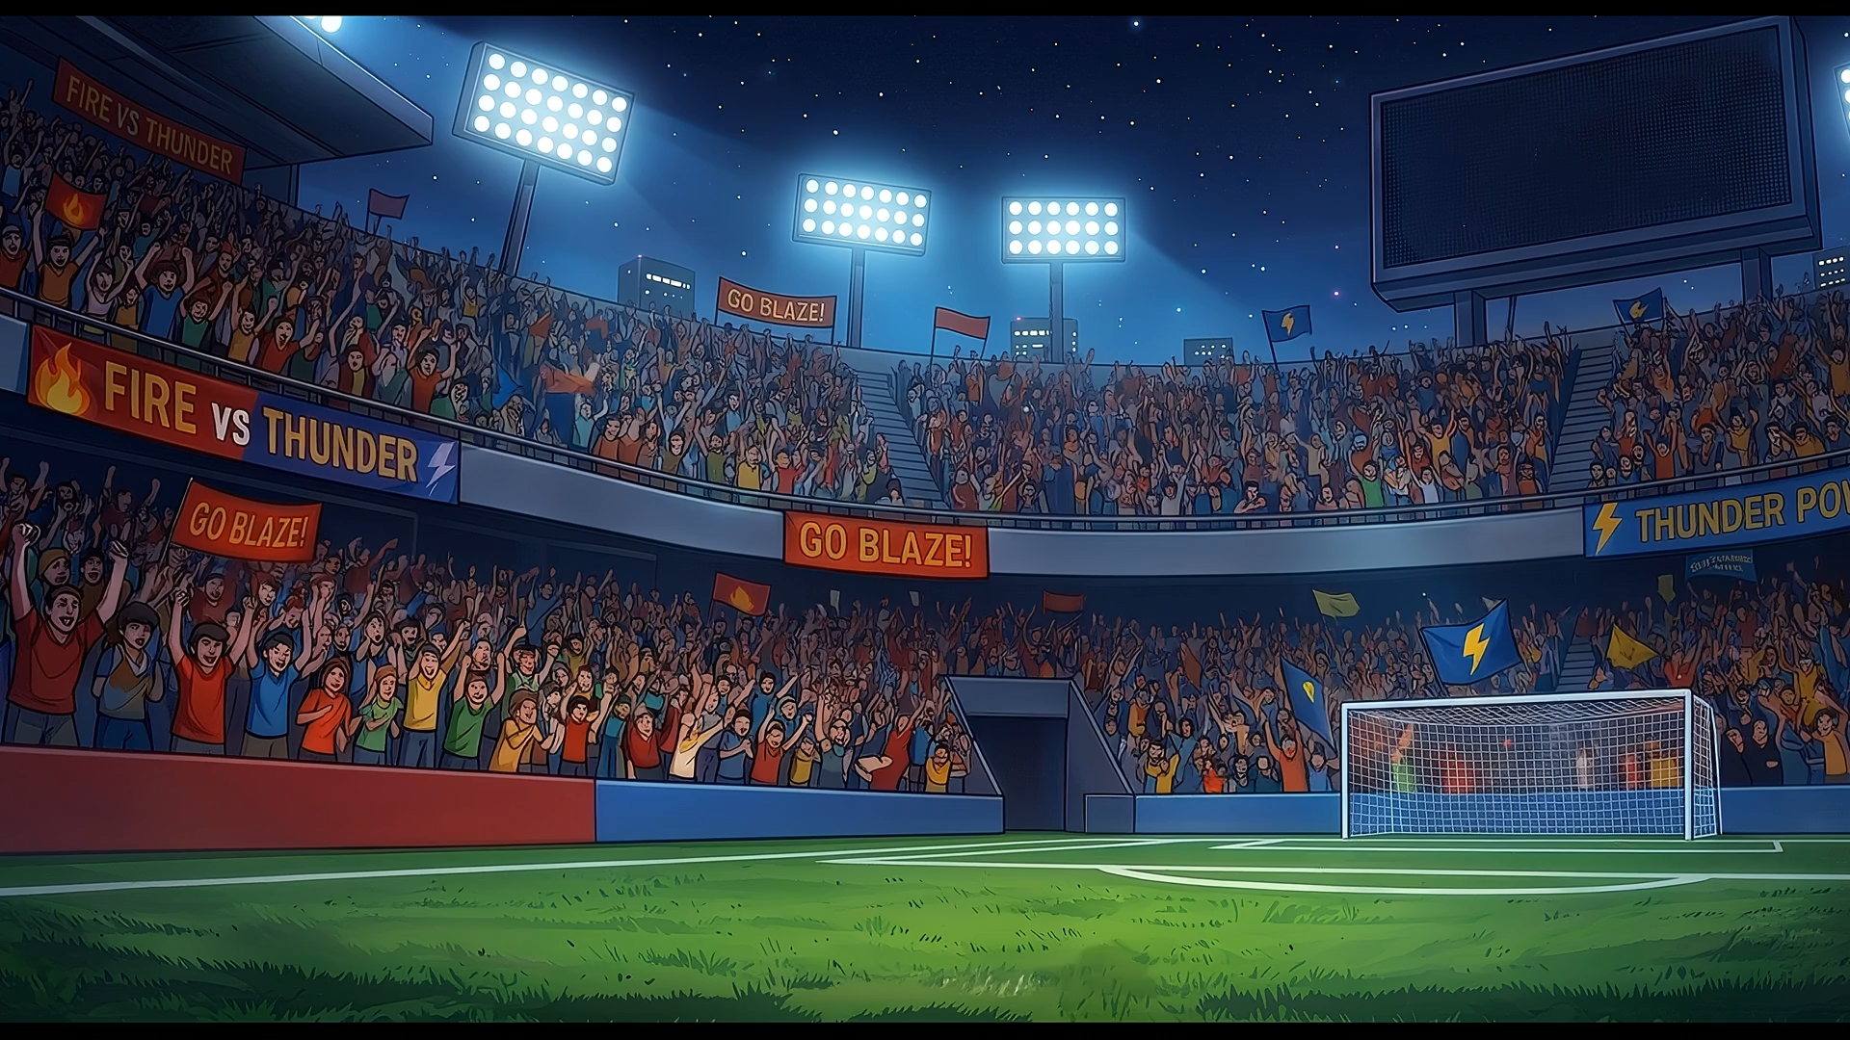

Slide 3
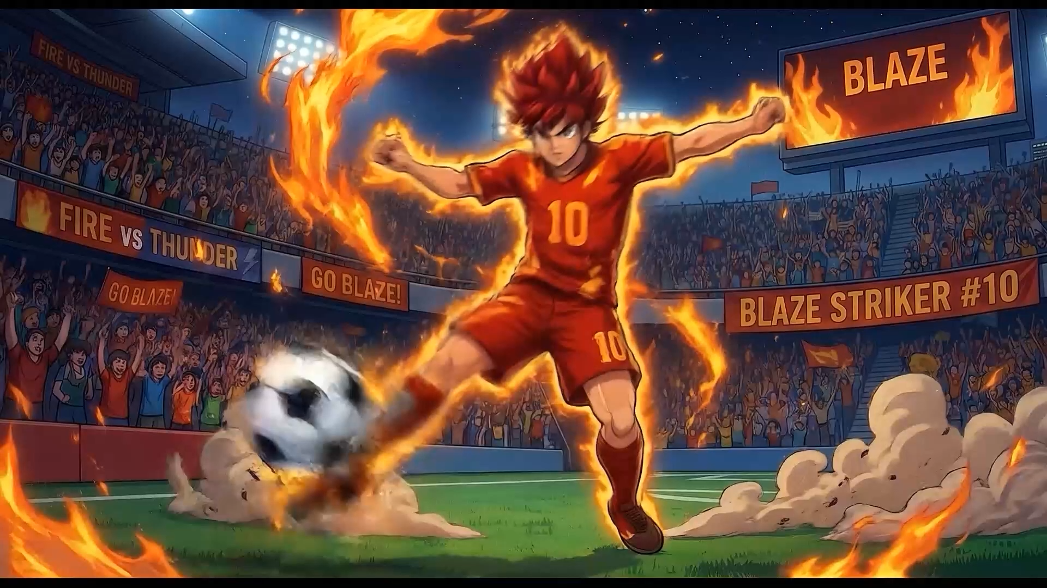
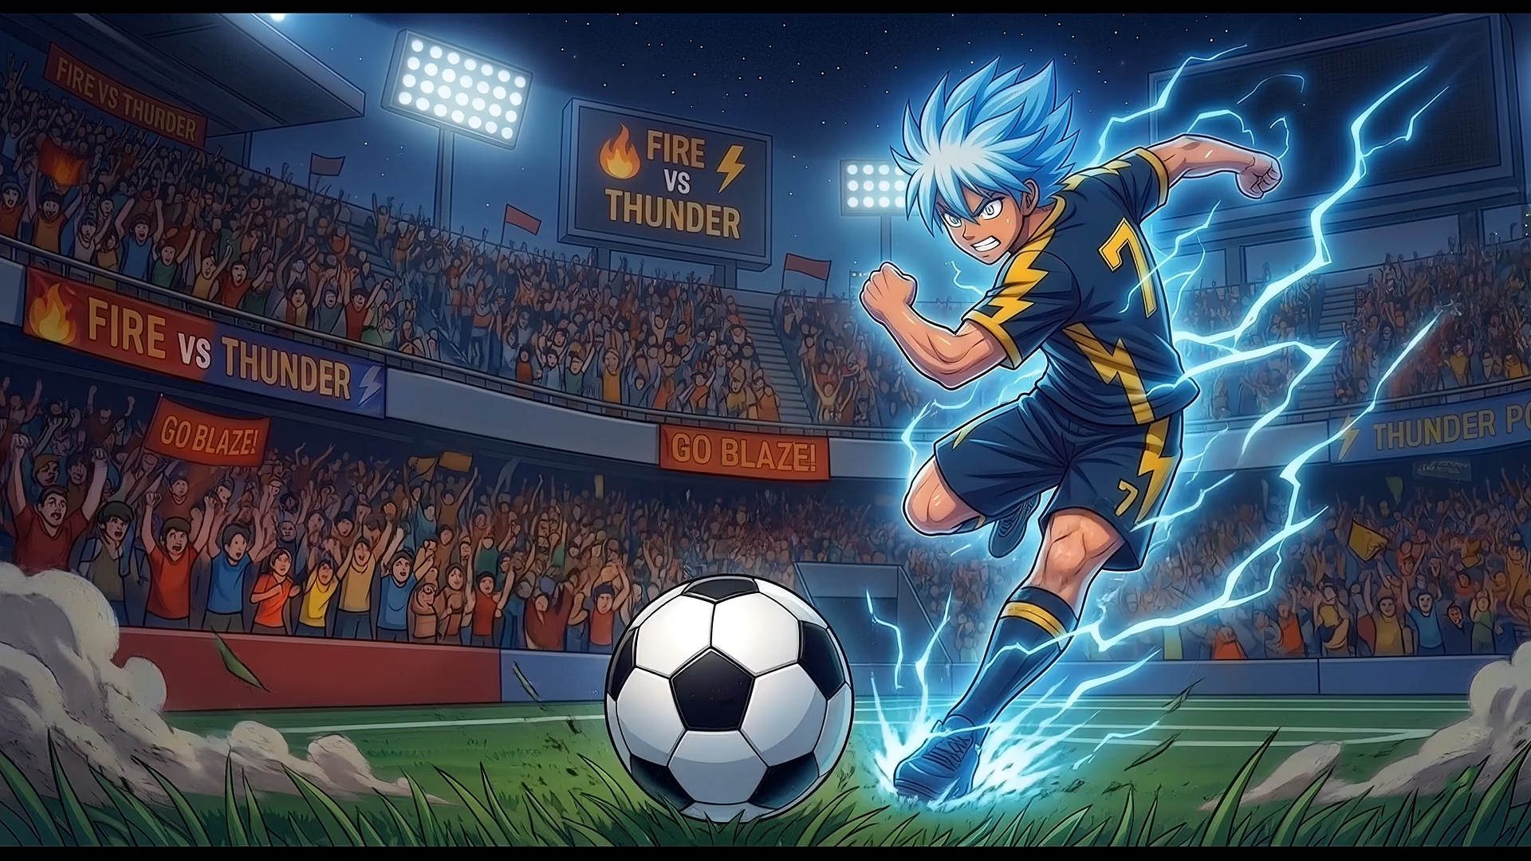
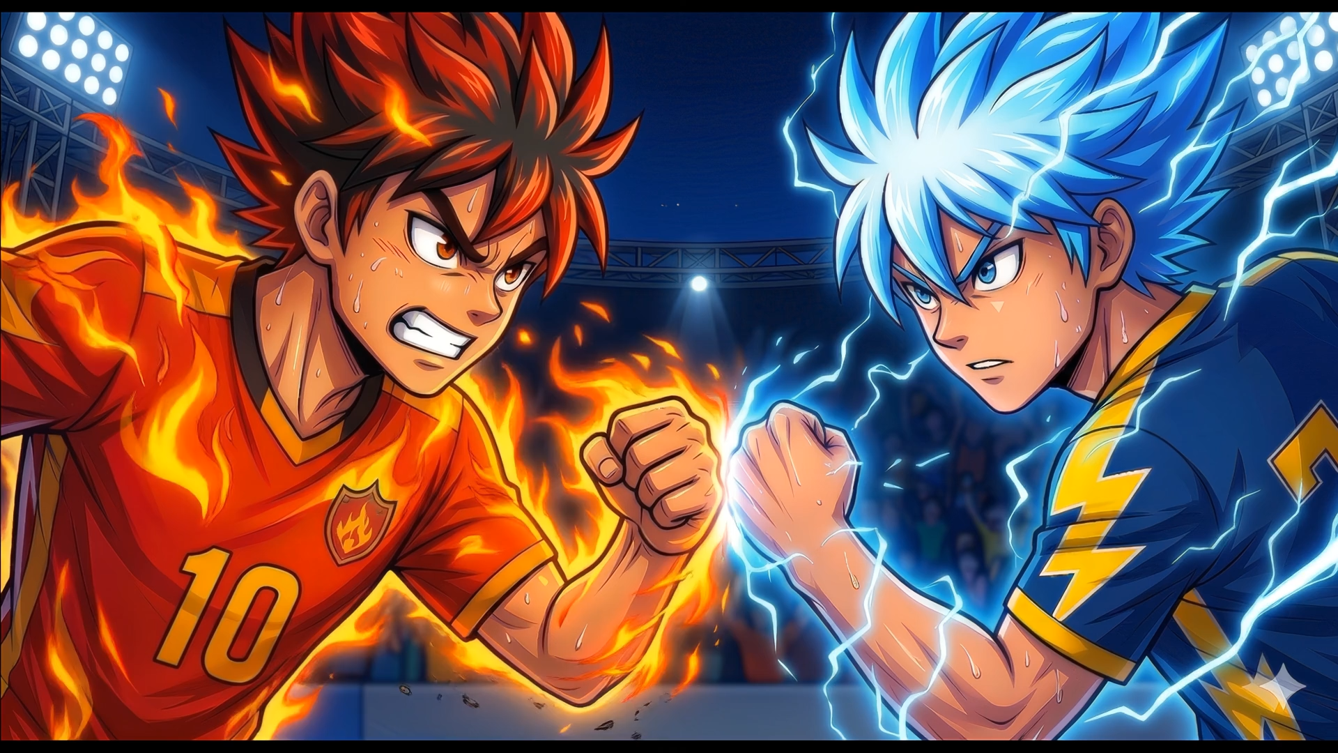



0
0
10
2
3
1
4
8
6
5
7
9
10
2
3
1
4
8
6
5
7
Champions Challenge
9
Fire Eagles
Thunder Heroes
Notes:
تم تنزيل هذا القالب من موقع ingez-ppt

Slide 4
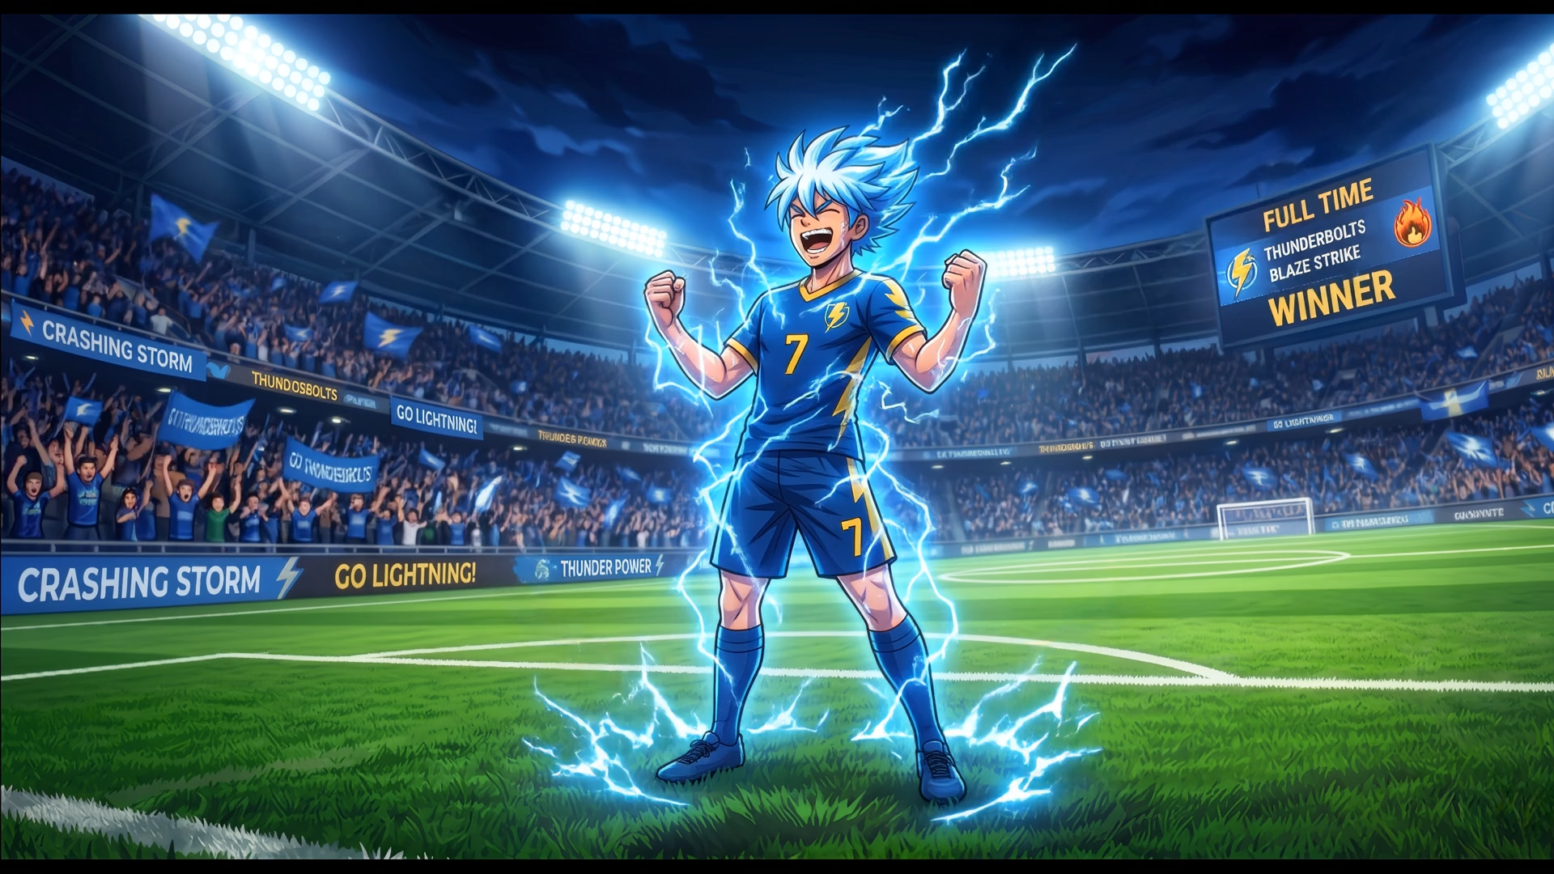
Congratulations
to the winning team

Slide 5
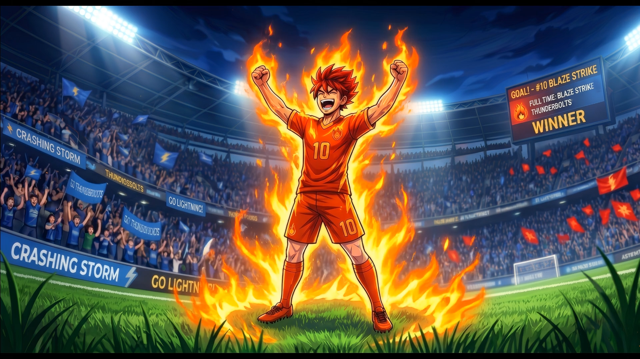
Congratulations
to the winning team

Slide 6


Slide 7


Usage Instructions
To edit this template, click the “Enable Editing” message that will appear below the main menus at the top of PowerPoint.
You can increase the team score by clicking the plus (+) icon on the match results board.
To go to the winning screen, click the trophy icon of the winning team on the results board.
The total number of points = 10 points for each team. The winning team is the first team to reach 10 points.
Do not delete or change the position of the slides.
Font used in the template: Montserrat (link)
To move to the winning team announcement screen, click on the trophy icon of the winning team.
Increase the team score by clicking the plus (+) icon.
This template was downloaded from ingez-ppt.com --a website for PowerPoint templates
Notes:
هذا القالب من تصميم موقع انجز ( ingez-ppt.com ) : موقع عربي متخصص بتصميم قوالب البوربوينت باللغة العربية

