Slide 1





Slide 2
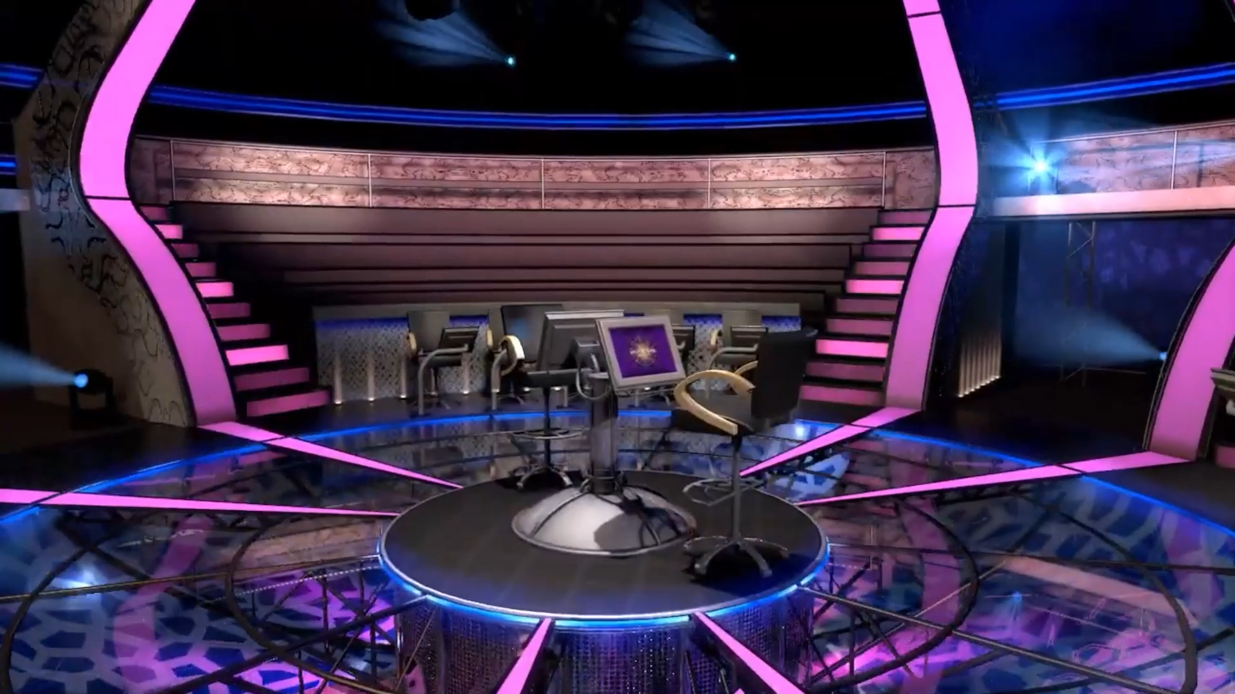

Slide 3
$ 500
This text is an example that you can edit within the same space, where you can add the question here without affecting the formatting
A: Wrong answer
B: Correct answer
C: Wrong answer
D: Wrong answer

Slide 4
14
13
12
11
10
9
8
7
6
5
4
3
2
1
$ 1 MILLION
$ 500,000
$ 250,000
$ 100,000
$ 50,000
$ 30,000
$ 20,000
$ 10,000
$ 7,000
$ 5,000
$ 3,000
$ 2,000
$ 1,000
$ 500

Slide 5
$ 1000
This text is an example that you can edit within the same space, where you can add the question here without affecting the formatting
A: Wrong answer
B: Wrong answer
C: Wrong answer
D: Correct answer

Slide 6
14
13
12
11
10
9
8
7
6
5
4
3
2
1
$ 1 MILLION
$ 500,000
$ 250,000
$ 100,000
$ 50,000
$ 30,000
$ 20,000
$ 10,000
$ 7,000
$ 5,000
$ 3,000
$ 2,000
$ 1,000
$ 500

Slide 7
$ 2000
This text is an example that you can edit within the same space, where you can add the question here without affecting the formatting
A: Correct answer
B: Wrong answer
C: Wrong answer
D: Wrong answer

Slide 8
14
13
12
11
10
9
8
7
6
5
4
3
2
1
$ 1 MILLION
$ 500,000
$ 250,000
$ 100,000
$ 50,000
$ 30,000
$ 20,000
$ 10,000
$ 7,000
$ 5,000
$ 3,000
$ 2,000
$ 1,000
$ 500

Slide 9
$ 3000
This text is an example that you can edit within the same space, where you can add the question here without affecting the formatting
A: Wrong answer
B: Correct answer
C: Wrong answer
D: Wrong answer

Slide 10
14
13
12
11
10
9
8
7
6
5
4
3
2
1
$ 1 MILLION
$ 500,000
$ 250,000
$ 100,000
$ 50,000
$ 30,000
$ 20,000
$ 10,000
$ 7,000
$ 5,000
$ 3,000
$ 2,000
$ 1,000
$ 500

Slide 11
$ 5000
This text is an example that you can edit within the same space, where you can add the question here without affecting the formatting
A: Wrong answer
B: Wrong answer
C: Correct answer
D: Wrong answer

Slide 12
14
13
12
11
10
9
8
7
6
5
4
3
2
1
$ 1 MILLION
$ 500,000
$ 250,000
$ 100,000
$ 50,000
$ 30,000
$ 20,000
$ 10,000
$ 7,000
$ 5,000
$ 3,000
$ 2,000
$ 1,000
$ 500

Slide 13
$ 7000
This text is an example that you can edit within the same space, where you can add the question here without affecting the formatting
A: Wrong answer
B: Wrong answer
C: Wrong answer
D: Correct answer

Slide 14
14
13
12
11
10
9
8
7
6
5
4
3
2
1
$ 1 MILLION
$ 500,000
$ 250,000
$ 100,000
$ 50,000
$ 30,000
$ 20,000
$ 10,000
$ 7,000
$ 5,000
$ 3,000
$ 2,000
$ 1,000
$ 500

Slide 15
$ 10000
This text is an example that you can edit within the same space, where you can add the question here without affecting the formatting
A: Correct answer
B: Wrong answer
C: Wrong answer
D: Wrong answer

Slide 16
14
13
12
11
10
9
8
7
6
5
4
3
2
1
$ 1 MILLION
$ 500,000
$ 250,000
$ 100,000
$ 50,000
$ 30,000
$ 20,000
$ 10,000
$ 7,000
$ 5,000
$ 3,000
$ 2,000
$ 1,000
$ 500

Slide 17
$ 20000
This text is an example that you can edit within the same space, where you can add the question here without affecting the formatting
A: Wrong answer
B: Correct answer
C: Wrong answer
D: Wrong answer

Slide 18
14
13
12
11
10
9
8
7
6
5
4
3
2
1
$ 1 MILLION
$ 500,000
$ 250,000
$ 100,000
$ 50,000
$ 30,000
$ 20,000
$ 10,000
$ 7,000
$ 5,000
$ 3,000
$ 2,000
$ 1,000
$ 500

Slide 19
$ 30000
This text is an example that you can edit within the same space, where you can add the question here without affecting the formatting
A: Correct answer
B: Wrong answer
C: Wrong answer
D: Wrong answer

Slide 20
14
13
12
11
10
9
8
7
6
5
4
3
2
1
$ 1 MILLION
$ 500,000
$ 250,000
$ 100,000
$ 50,000
$ 30,000
$ 20,000
$ 10,000
$ 7,000
$ 5,000
$ 3,000
$ 2,000
$ 1,000
$ 500

Slide 21
$ 50000
This text is an example that you can edit within the same space, where you can add the question here without affecting the formatting
A: Wrong answer
B: Wrong answer
C: Wrong answer
D: Correct answer

Slide 22
14
13
12
11
10
9
8
7
6
5
4
3
2
1
$ 1 MILLION
$ 500,000
$ 250,000
$ 100,000
$ 50,000
$ 30,000
$ 20,000
$ 10,000
$ 7,000
$ 5,000
$ 3,000
$ 2,000
$ 1,000
$ 500

Slide 23
$ 100000
This text is an example that you can edit within the same space, where you can add the question here without affecting the formatting
A: Wrong answer
B: Correct answer
C: Wrong answer
D: Wrong answer

Slide 24
14
13
12
11
10
9
8
7
6
5
4
3
2
1
$ 1 MILLION
$ 500,000
$ 250,000
$ 100,000
$ 50,000
$ 30,000
$ 20,000
$ 10,000
$ 7,000
$ 5,000
$ 3,000
$ 2,000
$ 1,000
$ 500

Slide 25
$ 250000
This text is an example that you can edit within the same space, where you can add the question here without affecting the formatting
A: Correct answer
B: Wrong answer
C: Wrong answer
D: Wrong answer

Slide 26
14
13
12
11
10
9
8
7
6
5
4
3
2
1
$ 1 MILLION
$ 500,000
$ 250,000
$ 100,000
$ 50,000
$ 30,000
$ 20,000
$ 10,000
$ 7,000
$ 5,000
$ 3,000
$ 2,000
$ 1,000
$ 500

Slide 27
$ 500000
This text is an example that you can edit within the same space, where you can add the question here without affecting the formatting
A: Wrong answer
B: Wrong answer
C: Correct answer
D: Wrong answer

Slide 28
14
13
12
11
10
9
8
7
6
5
4
3
2
1
$ 1 MILLION
$ 500,000
$ 250,000
$ 100,000
$ 50,000
$ 30,000
$ 20,000
$ 10,000
$ 7,000
$ 5,000
$ 3,000
$ 2,000
$ 1,000
$ 500

Slide 29

1 MILLION $

Slide 30


Slide 31

Usage Instructions
To edit this template, click the “Enable Editing” message that appears below the main menus at the top of the PowerPoint program.
Font used in the template: Montserrat (link)
This template was downloaded from: ingez-ppt.com a website specialized in designing PowerPoint templates
Notes:
هذا القالب من تصميم موقع انجز ( ingez-ppt.com ) : موقع عربي متخصص بتصميم قوالب البوربوينت باللغة العربية

